Slide 1


HTTP and the Fetch API
Muhammad Zahir Junejo

Slide 2


Lecture - Housekeeping
The use of disrespectful language is prohibited in the questions, this is a supportive, learning environment for all - please engage accordingly.
Please review Code of Conduct (in Student Undertaking Agreement) if unsure
No question is daft or silly - ask them!
Q&A session at the end of the lesson, should you wish to ask any follow-up questions.
Should you have any questions after the lecture, please schedule a mentor session.
For all non-academic questions, please submit a query: www.hyperiondev.com/support
Notes:
A data structure is a particular way of organizing data in a computer so that it can be used effectively.

Slide 3


What is HTTP(S)?
The HTTP Request-Response Cycle
Anatomy of an HTTP Request
Anatomy of an HTTP Response
Introducing the Fetch API
Making GET Requests with Fetch
Handling Responses with Fetch
Lecture Objectives

Slide 4
What is HTTP(S)?
HTTP(S), Hypertext Transfer Protocol (Secure), is the foundation of data communication on the World Wide Web. It defines how messages are formatted and transmitted and how web servers and browsers should respond to various commands.
HTTP is the standard protocol for transferring hypertext, typically in the form of HTML files, between a web server and a browser.
HTTPS is the secure version of HTTP, encrypting data to ensure privacy and security during transmission.
Notes:
A data structure is a particular way of organizing data in a computer so that it can be used effectively.

Slide 5
What is HTTP(S)?
HTTP(S), Hypertext Transfer Protocol (Secure), is the foundation of data communication on the World Wide Web. It defines how messages are formatted and transmitted and how web servers and browsers should respond to various commands.
HTTP is the standard protocol for transferring hypertext, typically in the form of HTML files, between a web server and a browser.
HTTPS is the secure version of HTTP, encrypting data to ensure privacy and security during transmission.
Notes:
A data structure is a particular way of organizing data in a computer so that it can be used effectively.

Slide 6
The HTTP Request-Response Cycle
HTTP operates as a request-response protocol, where clients (e.g., browsers) send requests to servers, and servers respond with data. This cycle forms the basis of web communication.
Client (Browser) sends an HTTP Request to the Server.
Server processes the request and generates an HTTP Response.
The Response is sent back to the Client.
The Client processes the Response and displays content.
Notes:
A data structure is a particular way of organizing data in a computer so that it can be used effectively.

Slide 7
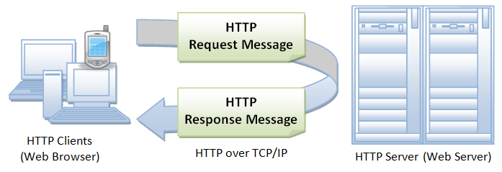
The HTTP Request-Response Cycle
Notes:
A data structure is a particular way of organizing data in a computer so that it can be used effectively.

Slide 8
Anatomy of an HTTP Request
HTTP Requests consist of several components:
Request Method (GET, POST, etc.)
URL
Headers (optional)
Body (optional, e.g., for POST requests)
GET /example-page HTTP/1.1
Host: www.example.com
User-Agent: Mozilla/5.0 (Windows NT 10.0; Win64; x64) AppleWebKit/537.36 (KHTML, like Gecko) Chrome/58.0.3029.110 Safari/537.36
Notes:
A data structure is a particular way of organizing data in a computer so that it can be used effectively.

Slide 9
Anatomy of an HTTP Response
HTTP Responses also consist of several components:
Status Code (e.g., 200 OK, 404 Not Found)
Headers (optional)
Body (contains the actual content)
HTTP/1.1 200 OK
Content-Type: text/html
Content-Length: 1234
<!DOCTYPE html>
<html>
<!-- ... -->
</html>
Notes:
A data structure is a particular way of organizing data in a computer so that it can be used effectively.

Slide 10
Introducing the Fetch API
The Fetch API is a modern JavaScript API for making HTTP requests in a more flexible and promise-based way. It replaces older methods like XMLHttpRequest.
Fetch is based on Promises, allowing for cleaner and more concise asynchronous code.
It supports a wide range of HTTP methods (GET, POST, PUT, DELETE, etc.).
Fetch is built into modern browsers, making it readily available for web developers.
Notes:
A data structure is a particular way of organizing data in a computer so that it can be used effectively.

Slide 11
Making Requests with Fetch
Making requests with Fetch is straightforward and involves specifying the URL you want to request.
Example:
// Making a GET request with Fetch
fetch('https://api.example.com/data')
.then(response => response.json())
.then(data => {
// Process the data
})
.catch(error => {
// Handle errors
});
Notes:
A data structure is a particular way of organizing data in a computer so that it can be used effectively.

Slide 12
References
https://developer.mozilla.org/en-US/docs/Web/HTTP
https://developer.mozilla.org/en-US/docs/Web/API/Fetch_API
https://developer.mozilla.org/en-US/docs/Web/API/Fetch_API/Using_Fetch
Notes:
A data structure is a particular way of organizing data in a computer so that it can be used effectively.

Slide 13


Questions and Answers

Slide 14
Thank You!

